Slide 1
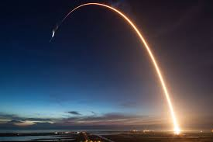
SpaceX Launch Success Rates
IBM Understanding Data Science
Capstone Project

Slide 2



Executive Summary
Introduction
Methodologies
Data Exploration
Model Results
Conclusion
Appendix

Slide 3
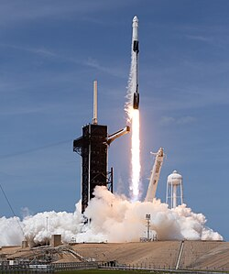
Executive Summary - Turning Historical Launch Data into Predictive Insight
Objective: Predict Launch Success
Data Science Methodology
Data Collection
Data Wrangling
Exploratory Data Analysis
Machine Learning Modeling
Model Evaluation
Data Scope:
90 SpaceX Launches over 10 Yrs (2010-20)
3 Launch Sites in California, Texas and Florida
Conclusion:
Best Model: 83.33% Test accuracy
Predicted: 88.93% Cross Validation Accuracy
Assume: Similar Rocket Design and Flight Parameters

Slide 4

Introduction – About this Project
Launch reliability drives mission success.
SpaceX data reveals performance patterns.
Historical trends inform predictive insight.
Objective: Forecast outcomes before liftoff.
Data reduces operational risk.
Models were rigorously evaluated.
Built for robustness and real-world use.
Key success drivers were identified.
Predictive power was demonstrated.
Analytics strengthens aerospace strategy.

Slide 5
✓
✓
✓
METHODOLGIES

Slide 6








Overall Project Methodology
Business Problem Definition
Translate stakeholder goals into a measurable ML problem with defined success metrics
Data Acquisition & Inventory
Identify and catalog relevant data sources across internal systems, third-party feeds, and public datasets
Exploratory Data Analysis (EDA)
Profile distributions, detect anomalies, and uncover relationships through statistical summaries and visualizations
Data Preprocessing & Feature Engineering
Handle missing values, encode categoricals, and engineer domain-informed variables to strengthen model signal
Model Selection & Baseline Establishment
Evaluate candidate algorithms against a simple baseline to guide complexity tradeoffs
Model Training & Cross-Validation
Train models using k-fold cross-validation to ensure robust, generalizable performance
Hyperparameter Tuning & Optimization
Apply grid search, random search, or Bayesian optimization to improve model performance
Model Evaluation & Interpretability
Assess final performance on a held-out test set; use SHAP or LIME for explainability

Slide 7
Data Collection & Wrangling Methodology
Step 1: Data Understanding
Identify and catalog data sources
Explore available fields and formats
Assess quality and identify challenges
Document limitations
Step 2: Data Collection
Design collection strategy
Implement extraction process
Validate during collection
Handle errors and log activities
Step 3: Data Wrangling
Clean data (missing values, errors, duplicates)
Transform data (engineering, encoding, scaling)
Integrate multiple sources
Validate quality comprehensively
Prepare final dataset

Slide 8
Exploratory Data Analysis Methodology
EDA Objectives
Univariate
Analysis
Understand the structure, patterns, and relationships within a dataset through statistical summaries and visualizations before formal modeling
Identify data quality issues, discover insights, generate hypotheses, and inform decisions about data cleaning, feature engineering, and appropriate analytical approaches
Bivariate
Analysis
Multivariate Analysis
Pattern & Anomaly Detection
Feature Characteristic
Domain Specific Analysis

Slide 9
Predictive Modeling Methodology
Objectives
Data Preprocessing and Split
Build accurate classification models that can predict target outcomes (categories/classes) based on input features using multiple algorithms (Logistic Regression, SVM, Decision Tree, KNN)
Compare and select the best-performing model by systematically evaluating each algorithm's performance using metrics like accuracy, precision, recall, and F1-score
Generate actionable business insights by interpreting model results, identifying key predictive features, and providing data-driven recommendations for decision-making
Model Training
Hyperparameter Tuning
For this project:
Logistic Regression
Support Vector Model
Decision Tree
K-Nearest Neighbor
Model Training
Model Evaluation
Model Interpretation

Slide 10

API Data Collection Steps
API Connection Test
Tests connection to SpaceX API
Validates API availability
Falls back to static JSON if needed
Load Lauch Data
Fetches SpaceX launch data
Loads from static JSON for consistency
Normalizes JSON into DataFrame
Data Processing
Filters to single-core launches
Filters to single-payload launches
Converts dates to proper format
Filters launches to November 2020
Extract Detailed Information
Booster Info
Payload
Launch Site
Core Details
Final Data Frame & Cleaning
Combine all data into one structure
Remove undefined landing outcomes
Validate Completeness
Save Data and Evaluate
Export to CSV
Display Summary Statistics
Show Outcome Distribution
API Data Summary:
Total Launches: 69
Date Range: 2013-09-29 to 2020-11-05
Launch Sites: 3
Booster Types: 1
Unique Outcomes: 6

Slide 11
✓
✓
✓
EDA Visualizations
Module 2 – Lab 2

Slide 12
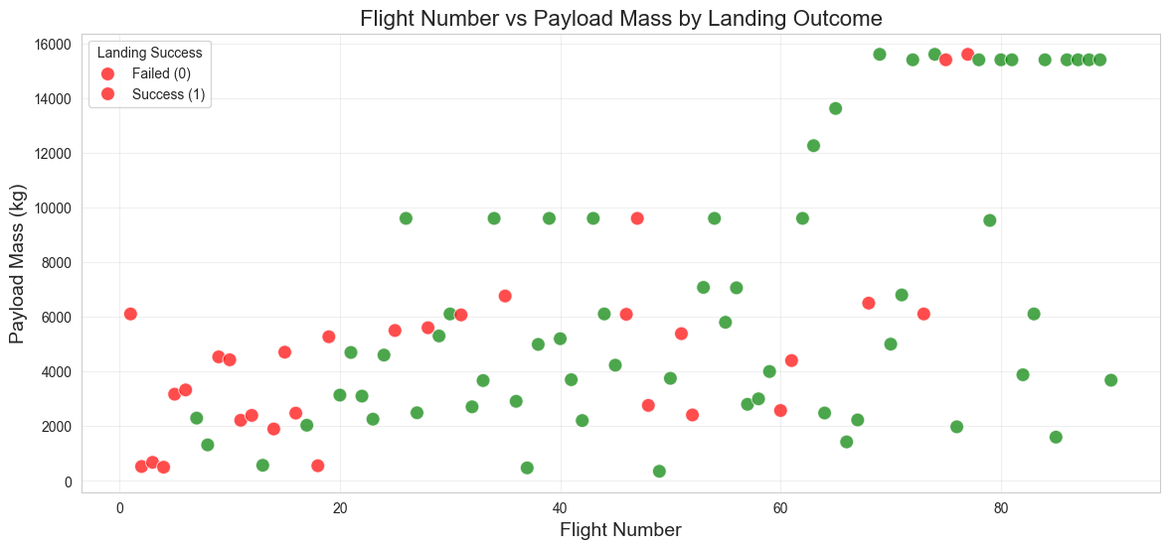
EDA With Visualization Results

Slide 13
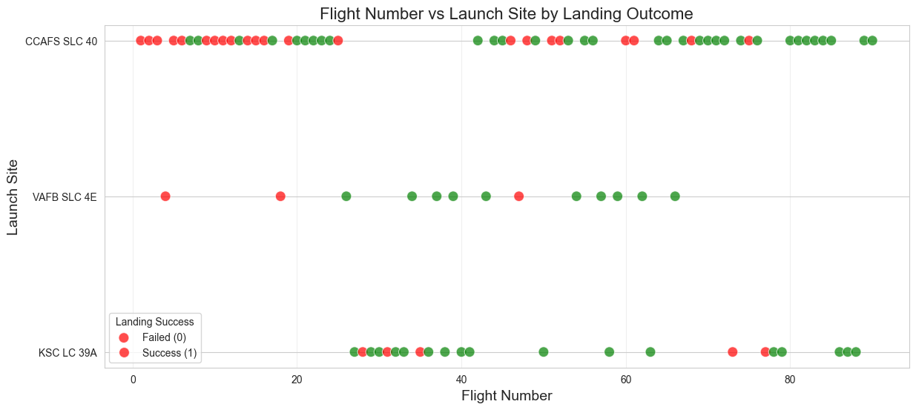
EDA With Visualization Results

Slide 14
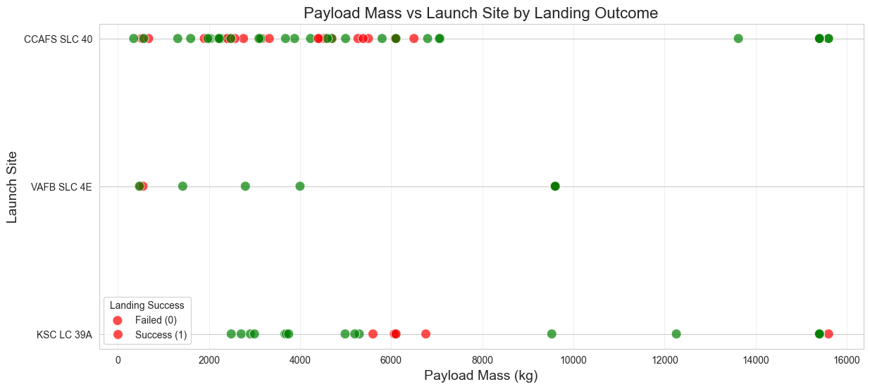
EDA With Visualization Results

Slide 15
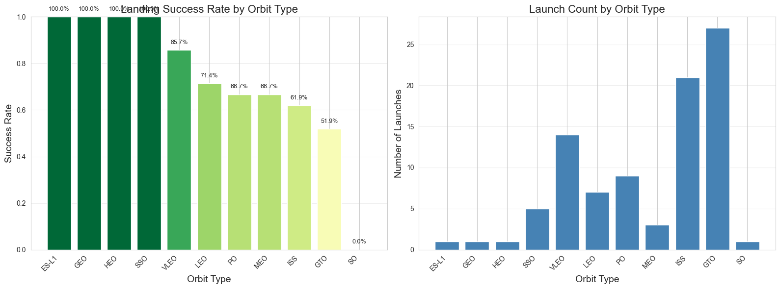
EDA With Visualization Results

Slide 16
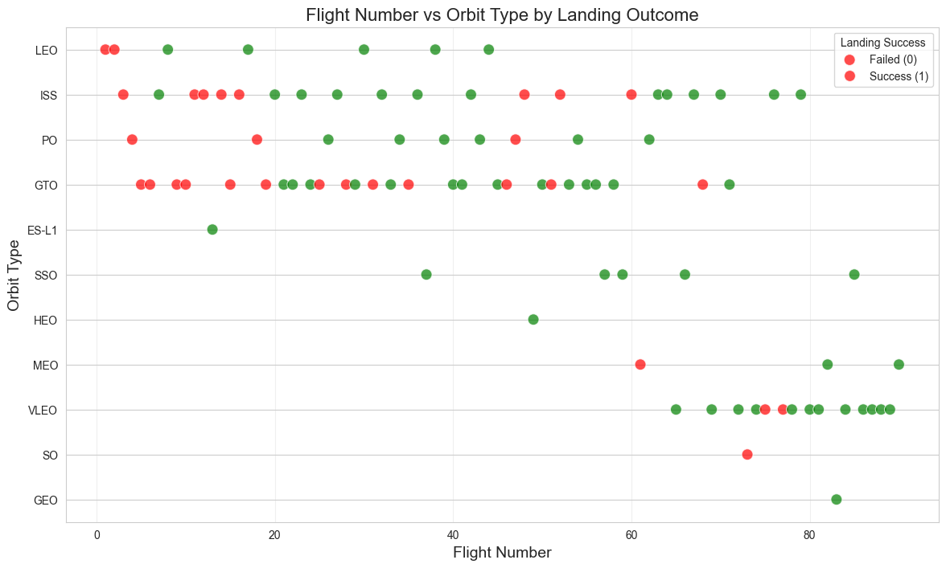
EDA With Visualization Results

Slide 17
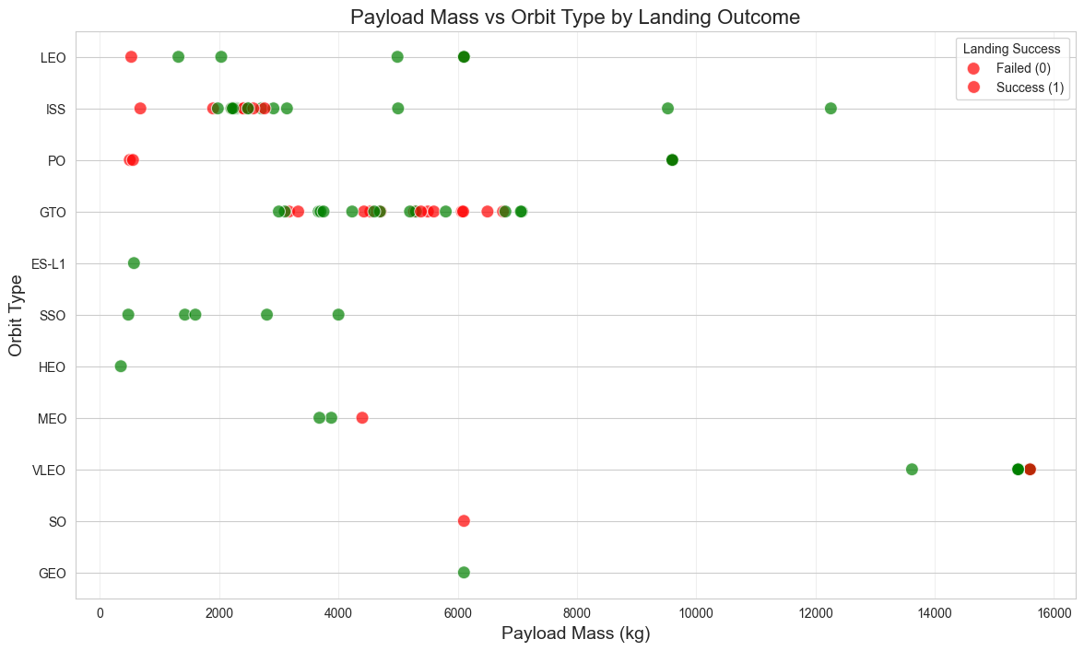
EDA With Visualization Results

Slide 18
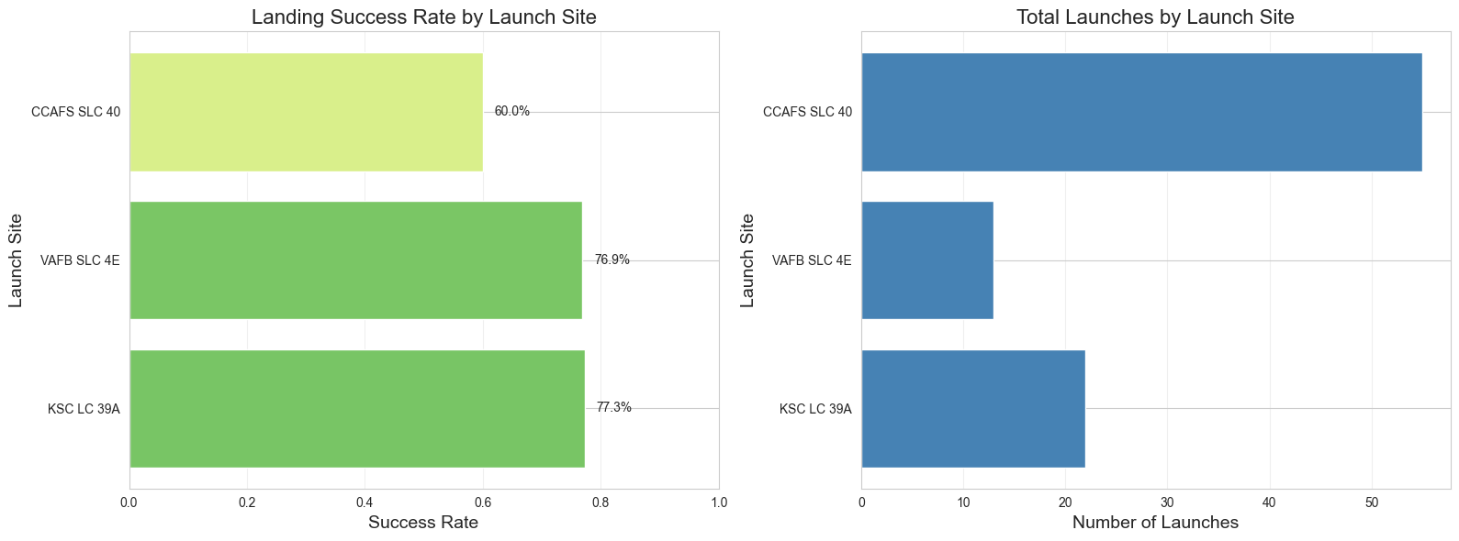
EDA With Visualization Results

Slide 19
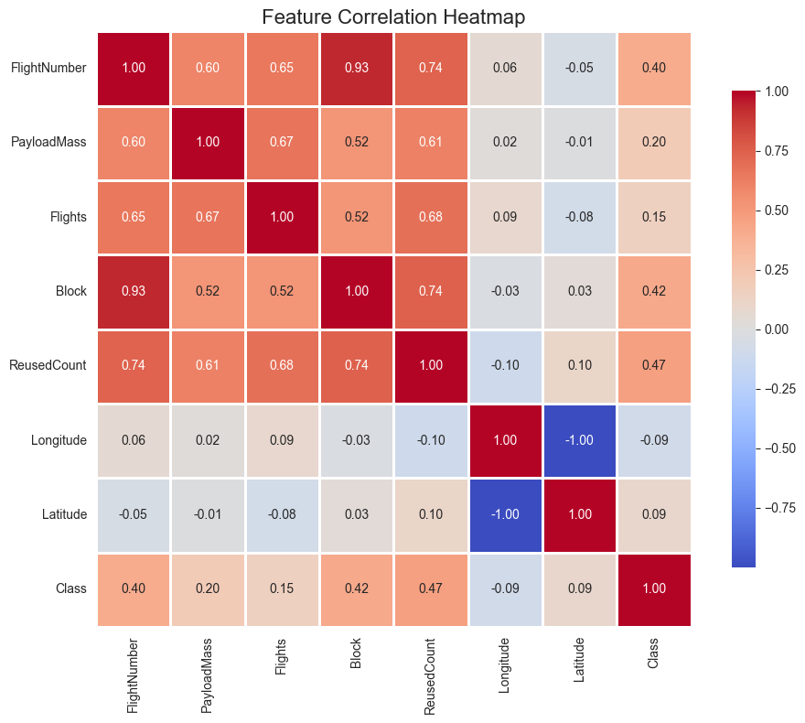
EDA With Visualization Results

Slide 20
EDA With Visualization – Key Findings
Metric | Value
Total Launches Analyzed | 90
Overall Success Rate | 66.67%
Number of Launch Sites | 3
Number of Orbit Types | 11
Payload Mass Range | 350 - 15,600 kg
Flight Number Range | 1 - 90

Slide 21
✓
✓
✓
EDA with SQL Visualizations
Module 2 – Lab 1

Slide 22
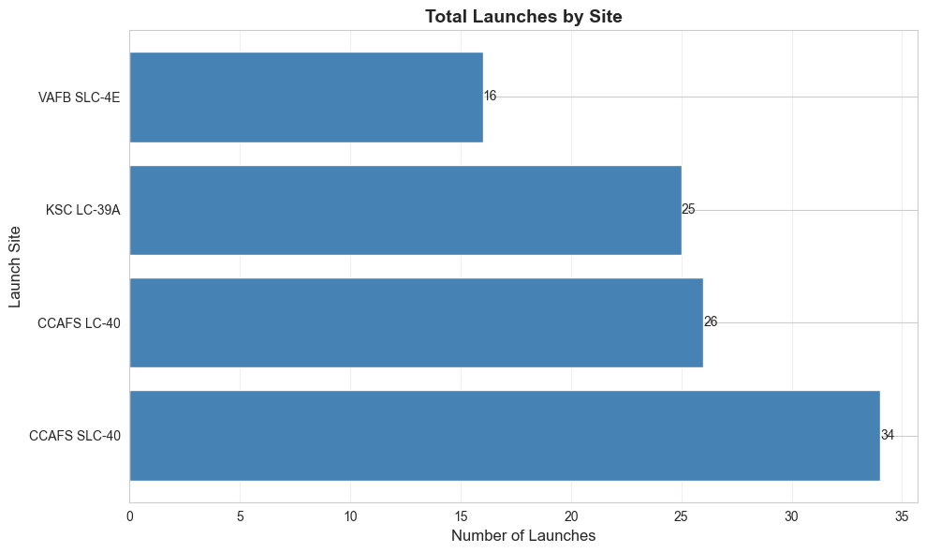
EDA With SQL Results – Task 1
Launch Sites
CCAFS LC-40
VAFB SLC-4E
KSC LC-39A
CCAFS SLC-40

Slide 23
EDA With SQL Results – Task 2 Results
First 5 records from Cape Canaveral (CCA)
Date | Time (UTC) | Booster_Version | Launch_Site | Payload | PAYLOAD_MASS__KG_ | Orbit | Customer | Mission_Outcome | Landing_Outcome
2010-06-04 | 18:45:00 | F9 v1.0 B0003 | CCAFS LC-40 | Dragon Spacecraft Qualification Unit | 0 | LEO | SpaceX | Success | Failure (parachute)
2010-12-08 | 15:43:00 | F9 v1.0 B0004 | CCAFS LC-40 | Dragon demo flight C1, two CubeSats, barrel of Brouere cheese | 0 | LEO (ISS) | NASA (COTS), NRO | Success | Failure (parachute)
2012-05-22 | 07:44:00 | F9 v1.0 B0005 | CCAFS LC-40 | Dragon demo flight C2 | 525 | LEO (ISS) | NASA (COTS) | Success | No attempt
2012-10-08 | 00:35:00 | F9 v1.0 B0006 | CCAFS LC-40 | SpaceX CRS-1 | 500 | LEO (ISS) | NASA (CRS) | Success | No attempt
2013-03-01 | 15:10:00 | F9 v1.0 B0007 | CCAFS LC-40 | (Payload not provided) | (Not provided) | (Unknown) | (Not provided) | (Not provided) | (Not provided)

Slide 24
EDA With SQL Results – Task 3
Total payload mass for NASA (CRS)
45596

Slide 25
EDA With SQL Results – Task 4
Average payload mass for F9 v1.1
2928.4

Slide 26
EDA With SQL Results – Task 5
FIRST_SUCCESSFUL_GROUND_PAD_LANDING_DATE:
2015-12-22

Slide 27
EDA With SQL Results – Task 6
Boosters with successful drone ship landings (4000-6000 kg)
Booster_Version
F9 FT B1022
F9 FT B1026
F9 FT B1021.2
F9 FT B1031.2
Create a visualization showing average for each booster

Slide 28
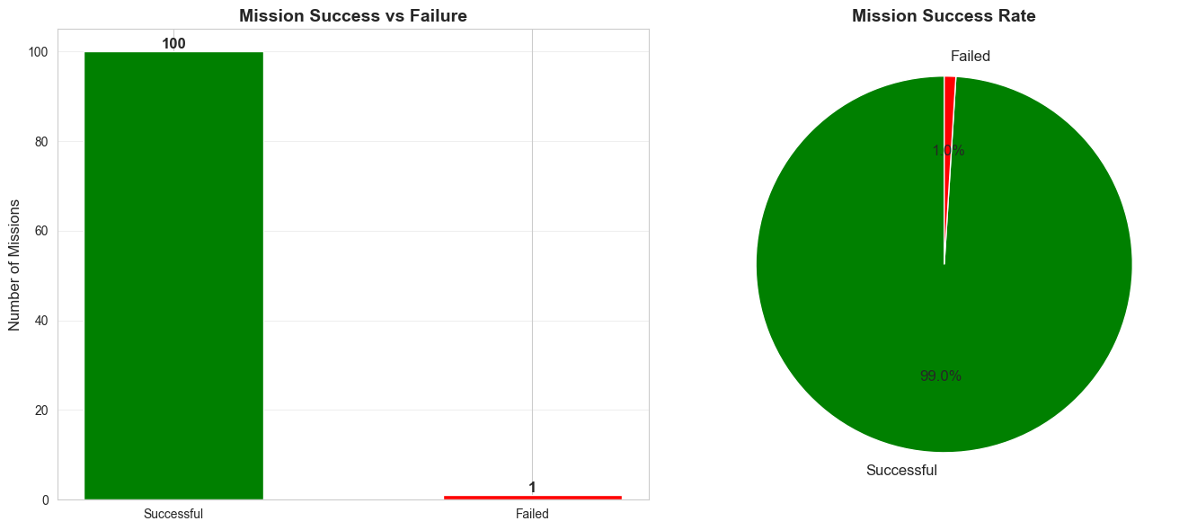
EDA With SQL Results – Task 7
Count of successful vs failed missions
SUCCESSFUL: 100
FAILED: 1
Success Rate:
99.01% (100/101)

Slide 29
EDA With SQL Results – Task 8
Boosters with successful drone ship landings (4000-6000 kg)
Results (4 rows):
Booster_Version
F9 FT B1022
F9 FT B1026
F9 FT B1021.2
F9 FT B1031.2

Slide 30
EDA With SQL Results – Task 9
Failed drone ship landings in 2015
MONTH_NAME | Landing_Outcome | Booster_Version | Launch_Site
January | Failure (drone ship) | F9 v1.1 B1012 | CCAFS LC-40
April | Failure (drone ship) | F9 v1.1 B1015 | CCAFS LC-40

Slide 31
EDA With SQL Results – Task 10 Results
Landing outcomes between June 2010 - March 2017
Outcome | Count
No attempt | 10
Success (drone ship) | 5
Failure (drone ship) | 5
Success (ground pad) | 3
Controlled (ocean) | 3
Uncontrolled (ocean) | 2
Failure (parachute) | 2
Precluded (drone ship) | 1

Slide 32
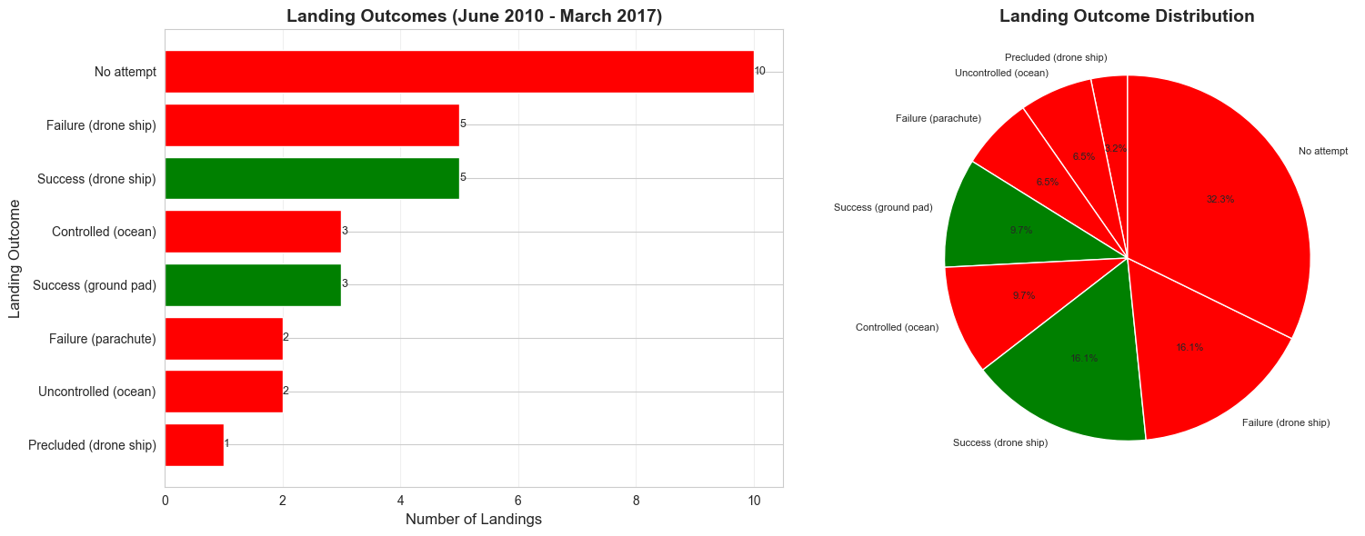
EDA With SQL Results – Task 10 Visualized
Landing outcomes between June 2010 - March 2017

Slide 33
✓
✓
✓
EDA with Folium Maps
Module 3 – Lab 1

Slide 34
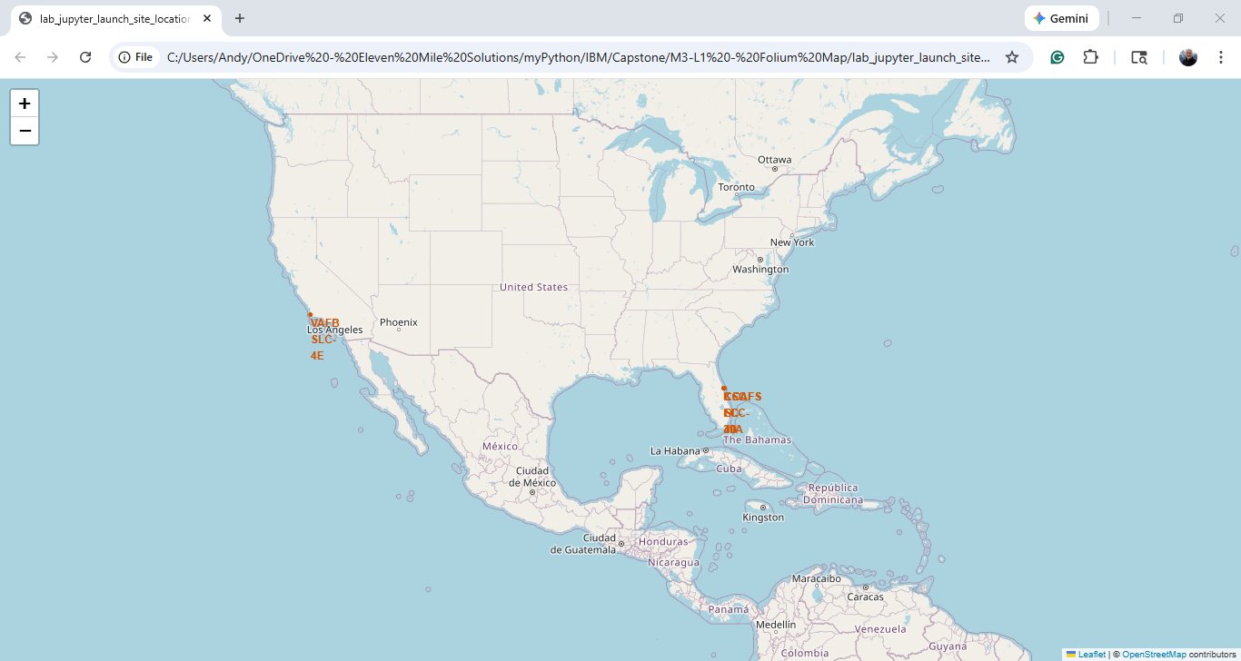
EDA With Folium Map – Task 1 - Marking Launch Sites

Slide 35
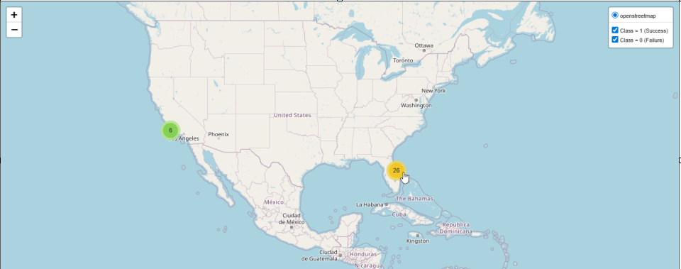
EDA With Folium Map – Task 2 - Marking Launch Outcomes 1

Slide 36
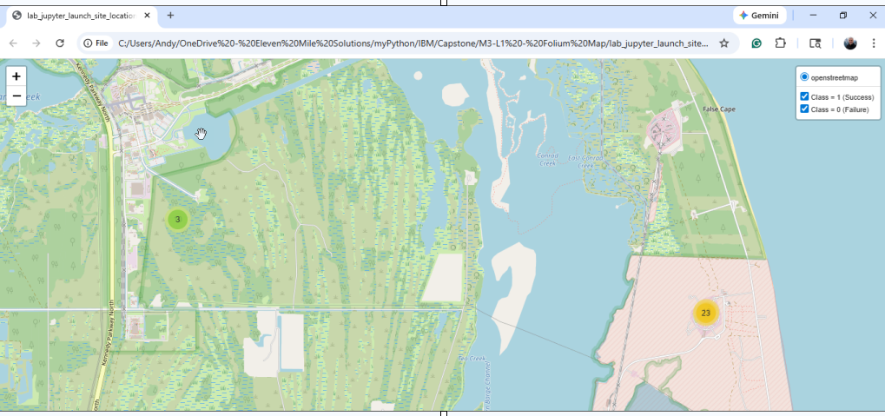
EDA With Folium Map – Task 2 Marking Launch Outcomes 2

Slide 37
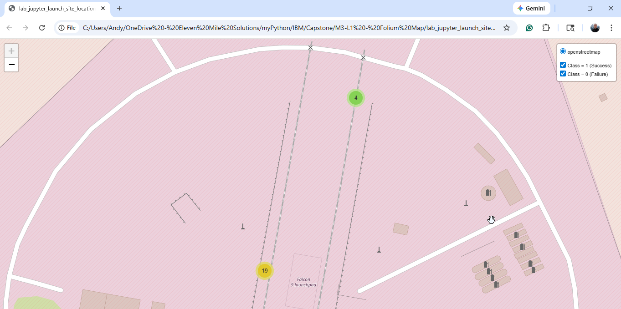
EDA With Folium Map – Task 2 - Marking Launch Outcomes 3

Slide 38
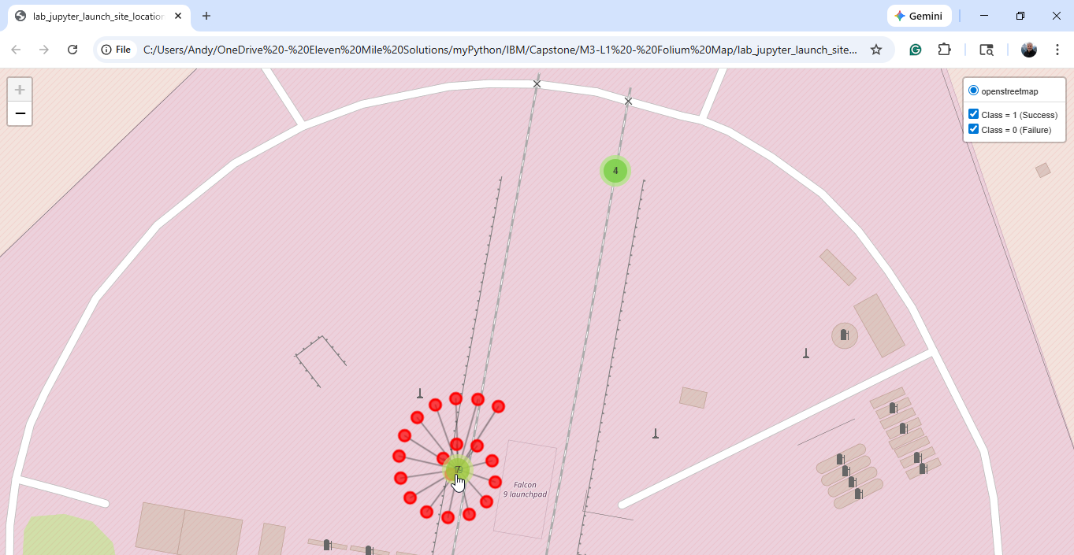
EDA With Folium Map– Task 2 - Marking Launch Outcomes 4

Slide 39
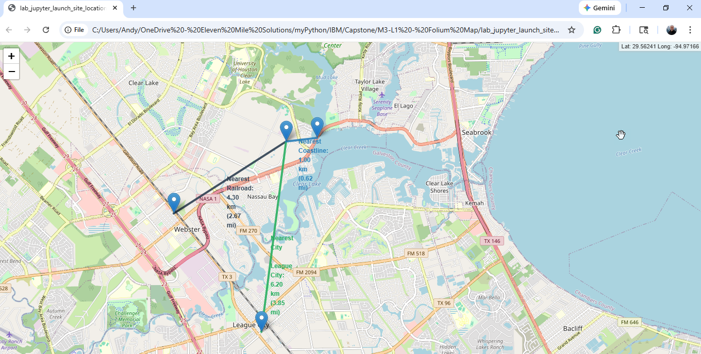
EDA With Folium Map– Task 3 – Polyline Proximity

Slide 40
✓
✓
✓
EDA with Plotly Interactive Dashboard
Module 3 – Lab 2

Slide 41
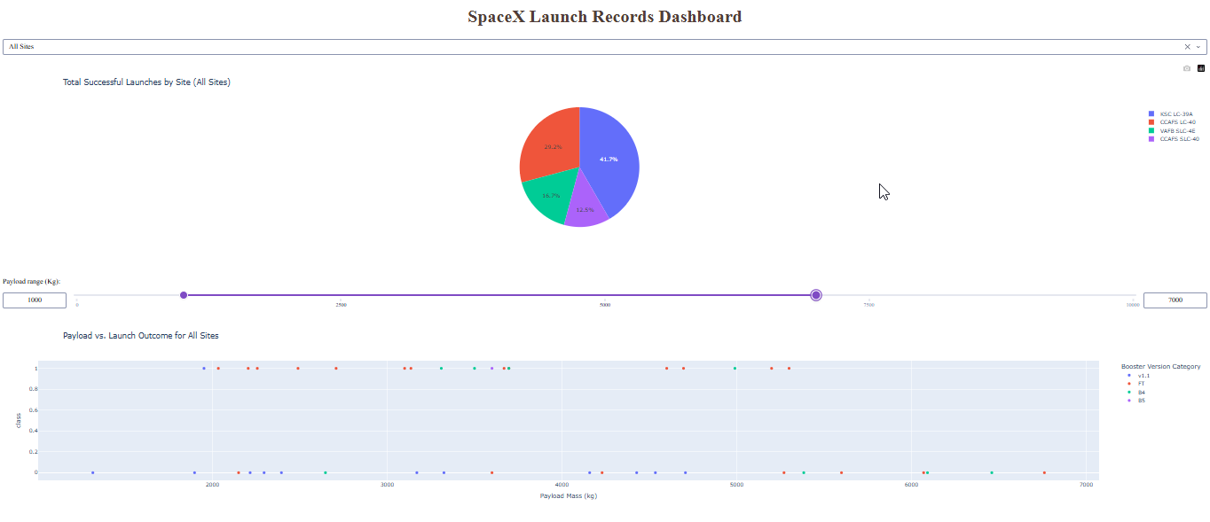
Plotly Interactive Dashboard – Visualization 1

Slide 42
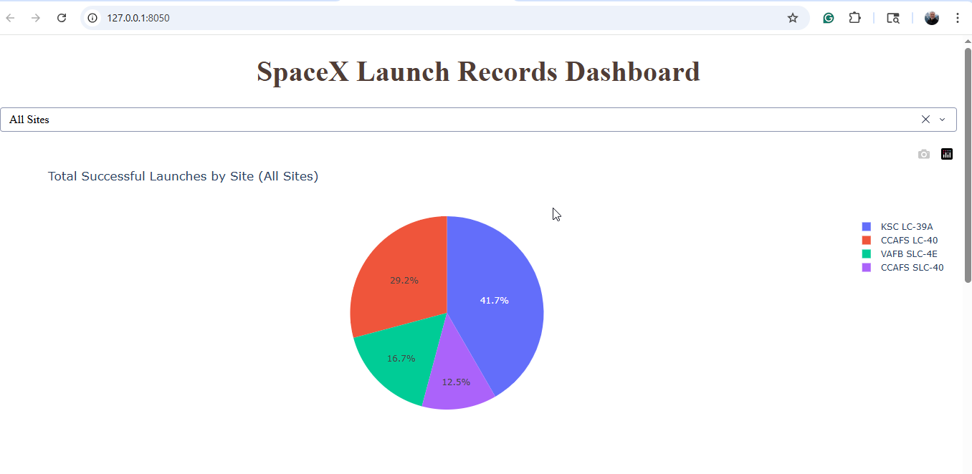
Plotly Interactive Dashboard – Visualization 2

Slide 43
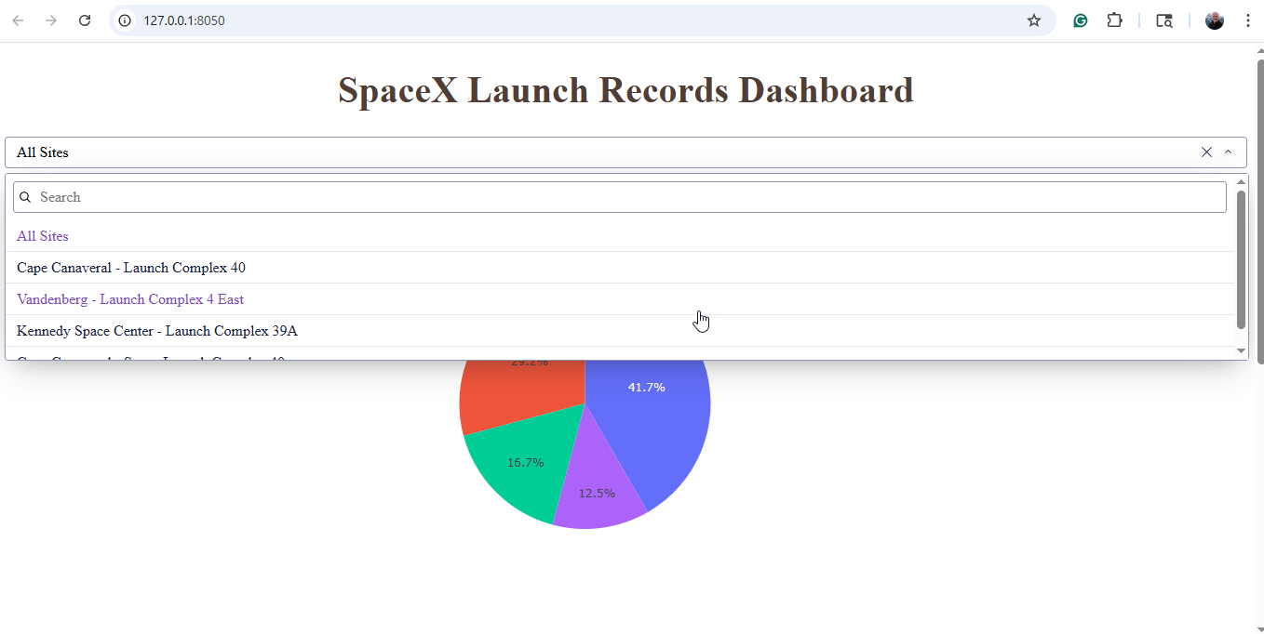
Plotly Interactive Dashboard – Visualization 3

Slide 44
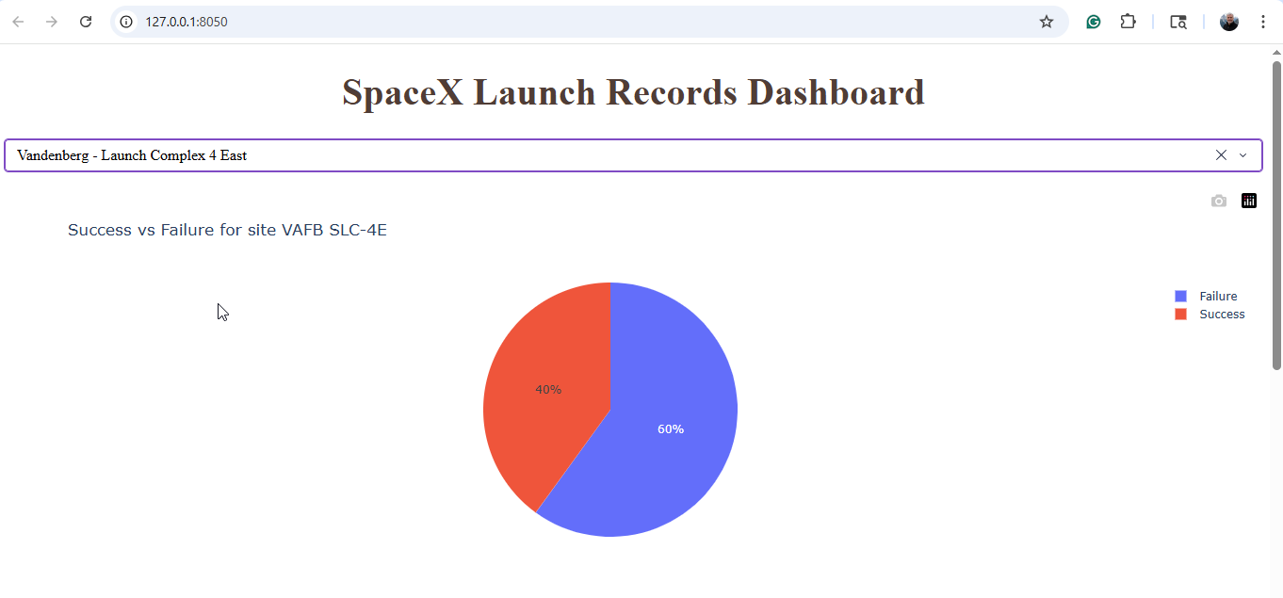
Plotly Interactive Dashboard – Visualization 4

Slide 45
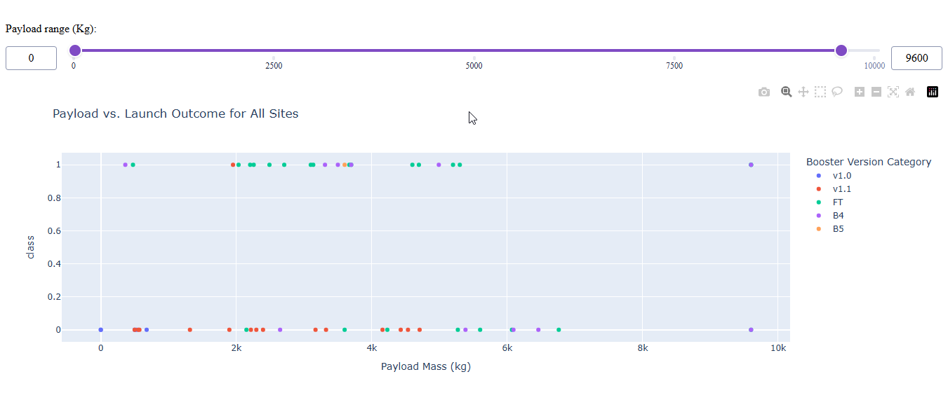
Plotly Interactive Dashboard – Visualization 5

Slide 46
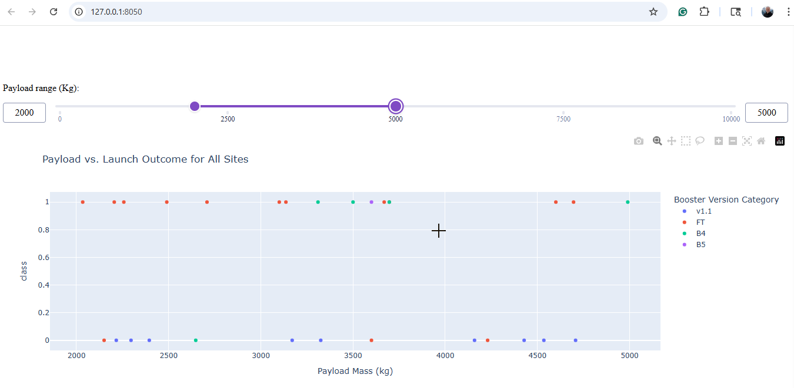
Plotly Interactive Dashboard – Visualization 6

Slide 47
✓
✓
✓
Predictive Analytics with Machine Learning
Module 4 – Lab 1

Slide 48
Logistic Regression – Key Metrics
📊 BASIC METRICS:
Accuracy: 0.7778 (77.78%)
Precision: 0.8333
Recall: 0.7778
F1-Score: 0.7381
🔍 CROSS-VALIDATION:
CV Accuracy: 0.8625
📈 PROBABILITY METRICS:
ROC AUC Score: 0.8611
Log Loss: 0.4993
⚙️ BEST HYPERPARAMETERS:
C: 0.01
max_iter: 1000
solver: lbfgs

Slide 49
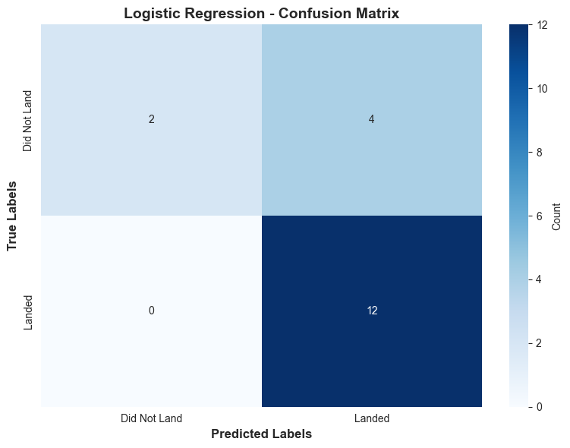
Logistic Regression - Confusion Matrix
🎯 CONFUSION MATRIX METRICS:
True Positives: 12
True Negatives: 2
False Positives: 4
False Negatives: 0
Sensitivity: 1.0000
Specificity: 0.3333

Slide 50
Support Vector Machine (SVM) – Key Metrics
📊 BASIC METRICS:
Accuracy: 0.7778 (77.78%)
Precision: 0.8333
Recall: 0.7778
F1-Score: 0.7381
🔍 CROSS-VALIDATION:
CV Accuracy: 0.8500
⚙️ BEST HYPERPARAMETERS:
C: 1
gamma: scale
kernel: rbf
📈 PROBABILITY METRICS:
ROC AUC Score: 0.8472
Log Loss: 0.4270

Slide 51
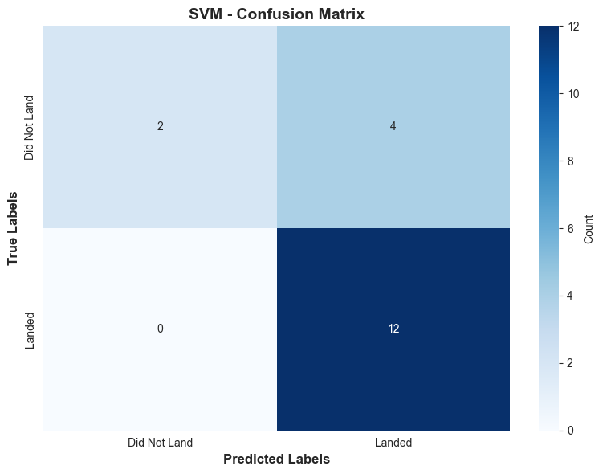
Support Vector Machine (SVM) – Confusion Matrix
🎯 CONFUSION MATRIX METRICS:
True Positives: 12
True Negatives: 2
False Positives: 4
False Negatives: 0
Sensitivity: 1.0000
Specificity: 0.3333

Slide 52
Decision Tree - Key Merics
🔍 CROSS-VALIDATION:
CV Accuracy: 0.8893
⚙️ BEST HYPERPARAMETERS:
criterion: gini
max_depth: 6
max_features: sqrt
min_samples_leaf: 1
min_samples_split: 5
splitter: best
📊 BASIC METRICS:
Accuracy: 0.8333 (83.33%)
Precision: 0.8308
Recall: 0.8333
F1-Score: 0.8291
📈 PROBABILITY METRICS:
ROC AUC Score: 0.7222
Log Loss: 4.1583

Slide 53
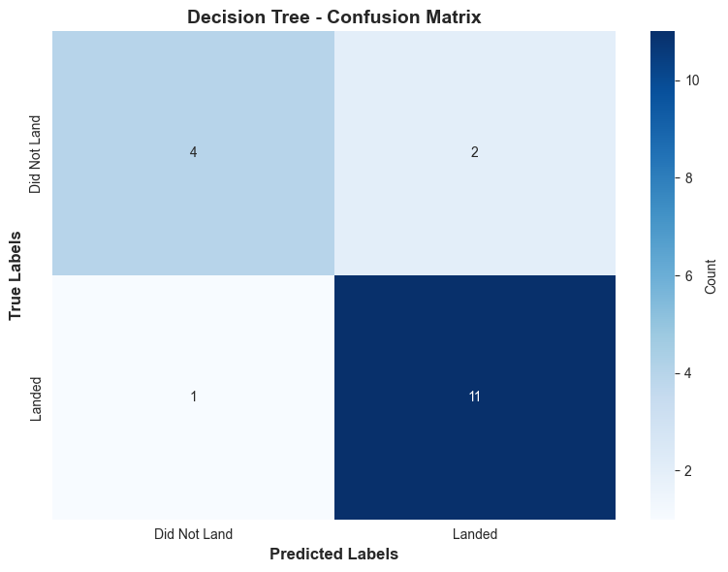
Decision Tree - Confusion Matrix
🎯 CONFUSION MATRIX METRICS:
True Positives: 11
True Negatives: 4
False Positives: 2
False Negatives: 1
Sensitivity: 0.9167
Specificity: 0.6667

Slide 54
K-Nearest Neighbor – Key Metrics
📊 BASIC METRICS:
Accuracy: 0.7778 (77.78%)
Precision: 0.8333
Recall: 0.7778
F1-Score: 0.7381
📈 PROBABILITY METRICS:
ROC AUC Score: 0.8403
Log Loss: 0.4568
🔍 CROSS-VALIDATION:
CV Accuracy: 0.8786
⚙️ BEST HYPERPARAMETERS:
algorithm: auto
n_neighbors: 9
p: 1
weights: uniform

Slide 55

K-Nearest Neighbor – Confusion Matrix
🎯 CONFUSION MATRIX METRICS:
True Positives: 12
True Negatives: 2
False Positives: 4
False Negatives: 0
Sensitivity: 1.0000
Specificity: 0.3333

Slide 56
Model Comparison - Conclusion
Metric | Logistic Regression | SVM | 🏆 Decision Tree | KNN
Accuracy | 0.7778 | 0.7778 | 0.8333 | 0.7778
Precision | 0.8333 | 0.8333 | 0.8308 | 0.8333
Recall | 0.7778 | 0.7778 | 0.8333 | 0.7778
F1-Score | 0.7381 | 0.7381 | 0.8291 | 0.7381
CV Accuracy | 0.8625 | 0.8500 | 0.8893 | 0.8786
Specificity | 0.3333 | 0.3333 | 0.6667 | 0.3333
Sensitivity | 1.0000 | 1.0000 | 0.9167 | 1.0000
ROC AUC | 0.8611 | 0.8472 | 0.7222 | 0.8403
Log Loss | 0.4993 | N/A | N/A | N/A
🏆 BEST MODEL: Decision Tree - Test Accuracy: 0.8333 (83.33%)
🎯 BEST CV SCORE: Decision Tree - CV Accuracy: 0.8893 (88.93%)

Slide 57
✓
✓
✓
Appendices

Slide 58
Appendix: GitHub Repository Link
https://github.com/andyflorence/IBM-Capstone-Project

Slide 59
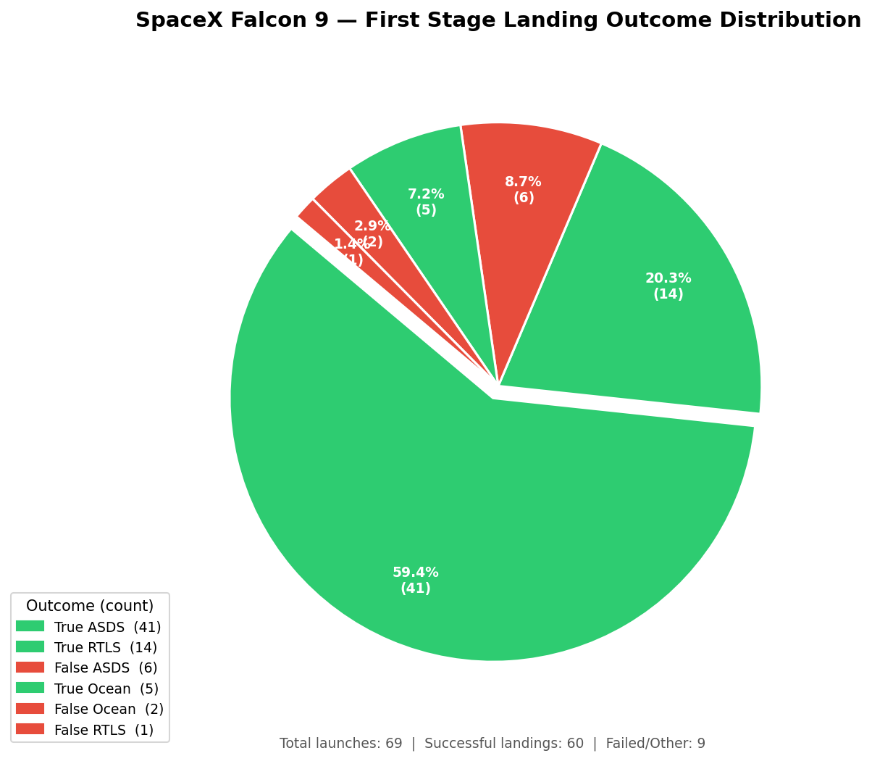
Appendix: About the SpaceX API Data
Data Types:
FlightNumber int64
Date object
BoosterVersion object
PayloadMass float64
Orbit object
LaunchSite object
Outcome object
Flights int64
GridFins bool
Reused bool
Legs bool
LandingPad object
Block float64
ReusedCount int64
Serial object
Longitude float64
Latitude float64
Missing Values:
FlightNumber 0
Date 0
BoosterVersion 0
PayloadMass 3
Orbit 0
LaunchSite 0
Outcome 0
Flights 0
GridFins 0
Reused 0
Legs 0
LandingPad 7
Block 0
ReusedCount 0
Serial 0
Longitude 0
Latitude 0

